Slide 1
LLM Project: Building a News Research Tool
Presented By
Vivek Rajput

Slide 2
Project Overview :
The Equity Research News Tool is a comprehensive language model (LLM) project designed for equity research analysts. Leveraging the power of langchain, the OpenAI API, and FAISS, this tool allows analysts to conduct efficient and insightful news research in the ever-evolving financial landscape.
The primary objective of this project is to create a user-friendly web application that enables equity research analysts to gather relevant news articles based on their queries, perform natural language processing (NLP) tasks using langchain, generate human-like text with OpenAI, and utilize FAISS for efficient similarity search.
News Research Tool using LLM (RAG implementation on unstructured web links)
This Python program is a news research tool that utilizes the power of the Mistral Large Language Model (LLM) to analyze and answer your questions across various websites.
Whether you’re a researcher, journalist, or just curious about current events, this tool provides an efficient way to gather relevant information.

Slide 3
Technologies Used:
Langchain: A versatile natural language processing library used for tasks such as entity recognition, sentiment analysis, and more.
OpenAI API: Integrated to generate coherent and contextually relevant text based on user queries.
FAISS: Employed for efficient similarity search and clustering of news articles based on precomputed embeddings.
Streamlit: Chosen for building an interactive and intuitive user interface for the Equity Research News Tool.

Slide 4
Project Features and Functionality
User-Friendly Interface:
Streamlit provides a clean and intuitive interface, making it easy for analysts to interact with the tool. Natural Language Processing (Langchain):
Langchain is utilized for various NLP tasks, such as entity recognition, sentiment analysis, and more, providing valuable insights into the content of news articles. Text Generation (OpenAI API):
OpenAI API is employed to generate human-like summaries or responses, enhancing the tool's capabilities in providing concise and informative outputs. Similarity Search (FAISS):
FAISS is integrated to perform efficient similarity search on precomputed news embeddings, allowing analysts to find articles related to their queries based on content similarity.

Slide 5
Provide a list of website URLs
Ask a question related to the content on any of the provided websites, or about the combined information from all sites
The program retrieves relevant information from the websites and uses Mistral to answer your question in a comprehensive way.

Slide 6
How It Works :
User Input:
Analysts input their queries or topics of interest into the web application. Natural Language Processing:
Langchain processes the input text, extracting entities, sentiments, or other relevant information. Text Generation:
The processed information is used as input for the OpenAI API to generate human-like summaries or responses. Similarity Search:
FAISS performs similarity search on precomputed embeddings of news articles, presenting the user with articles closely related to their query. Results Display:
The tool displays the processed NLP insights, generated text, and similar news articles to the analyst through a user-friendly interface.

Slide 7
Future Enhancements:
Real-Time Data Integration:
Incorporate real-time data feeds for up-to-the-minute news analysis. User Preferences:
Allow users to customize and prioritize specific entities or topics in their search results. Interactive Visualizations:
Implement visualizations to enhance the understanding of news data trends and relationships.

Slide 8
Benefits
Saves time and effort by eliminating the need to manually search and analyze multiple websites.
Gains insights from the combined knowledge of multiple news sources.
Leverages the power of Mistral's advanced language processing capabilities for accurate and insightful answers.

Slide 9
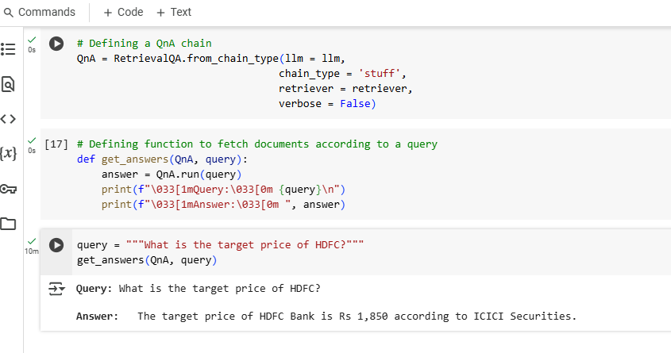
Screenshots

Slide 10
Conclusion:
The Equity Research News Tool is a powerful asset for equity research analysts, offering a seamless blend of natural language processing, text generation, and similarity search. By combining langchain, the OpenAI API, and FAISS, this tool empowers analysts to stay informed and make data-driven decisions in the dynamic world of financial research. As the financial landscape evolves, so too does the Equity Research News Tool, promising continuous improvement and adaptability.

Slide 11
Thank You

